Slide 1
Cloud Computing
Foundation

Slide 2
Agenda
Cloud
Servers
Data Center
Types of Cloud
On-Premise
Virtualization
API
Availability Zones (AZ) & Regions
Load Balancer
Scalability
Elasticity
Disaster Recovery

Slide 3
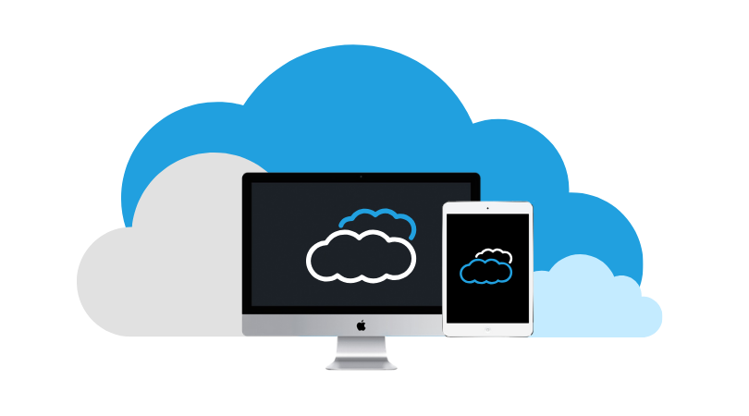


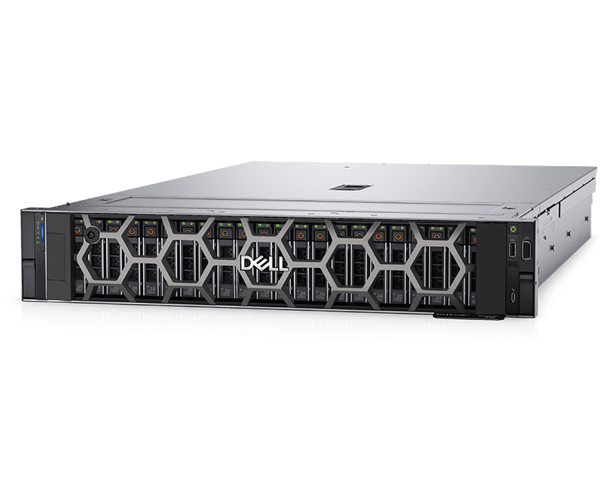


Server
Cloud
End User

Slide 4
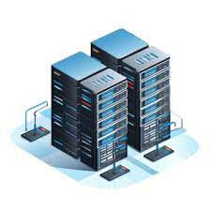
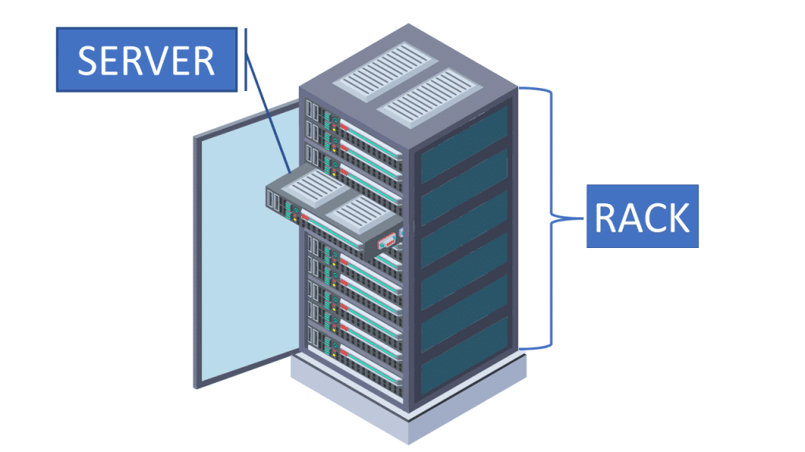
Data Center

Slide 5
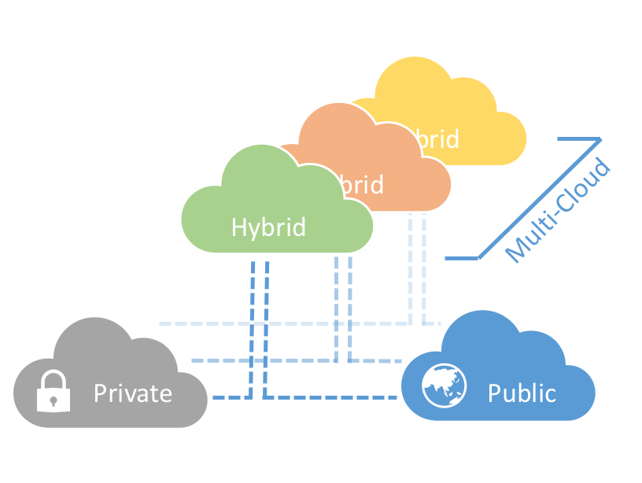
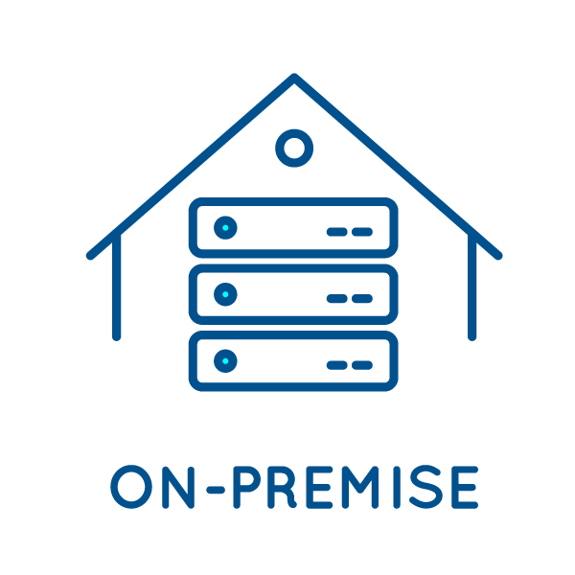

Slide 6
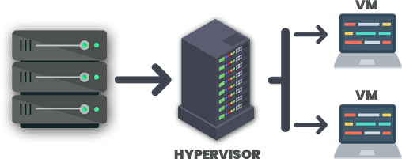

Slide 7
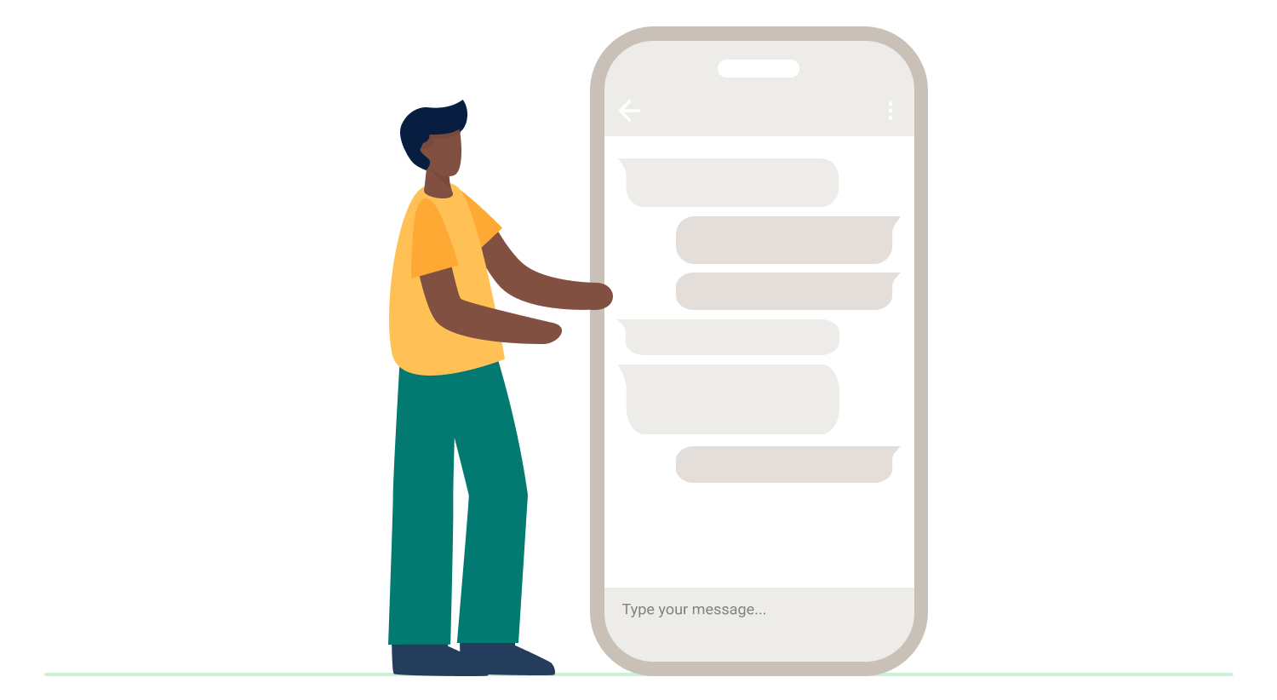

User Interface

Slide 8
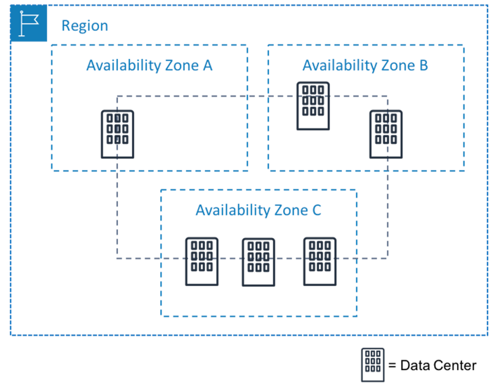

Slide 9
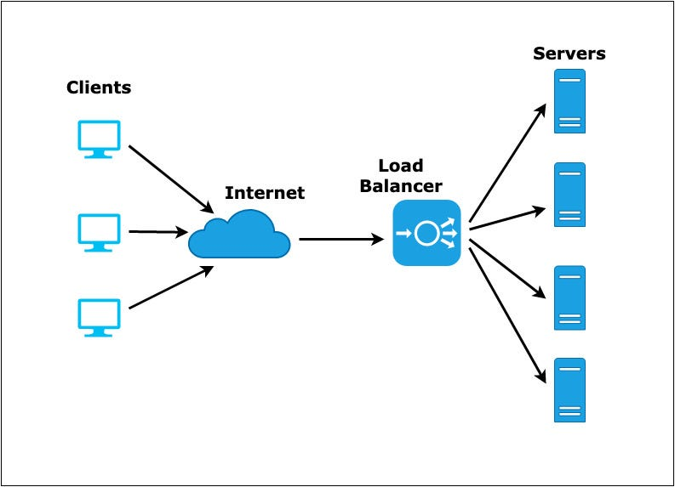

Slide 10
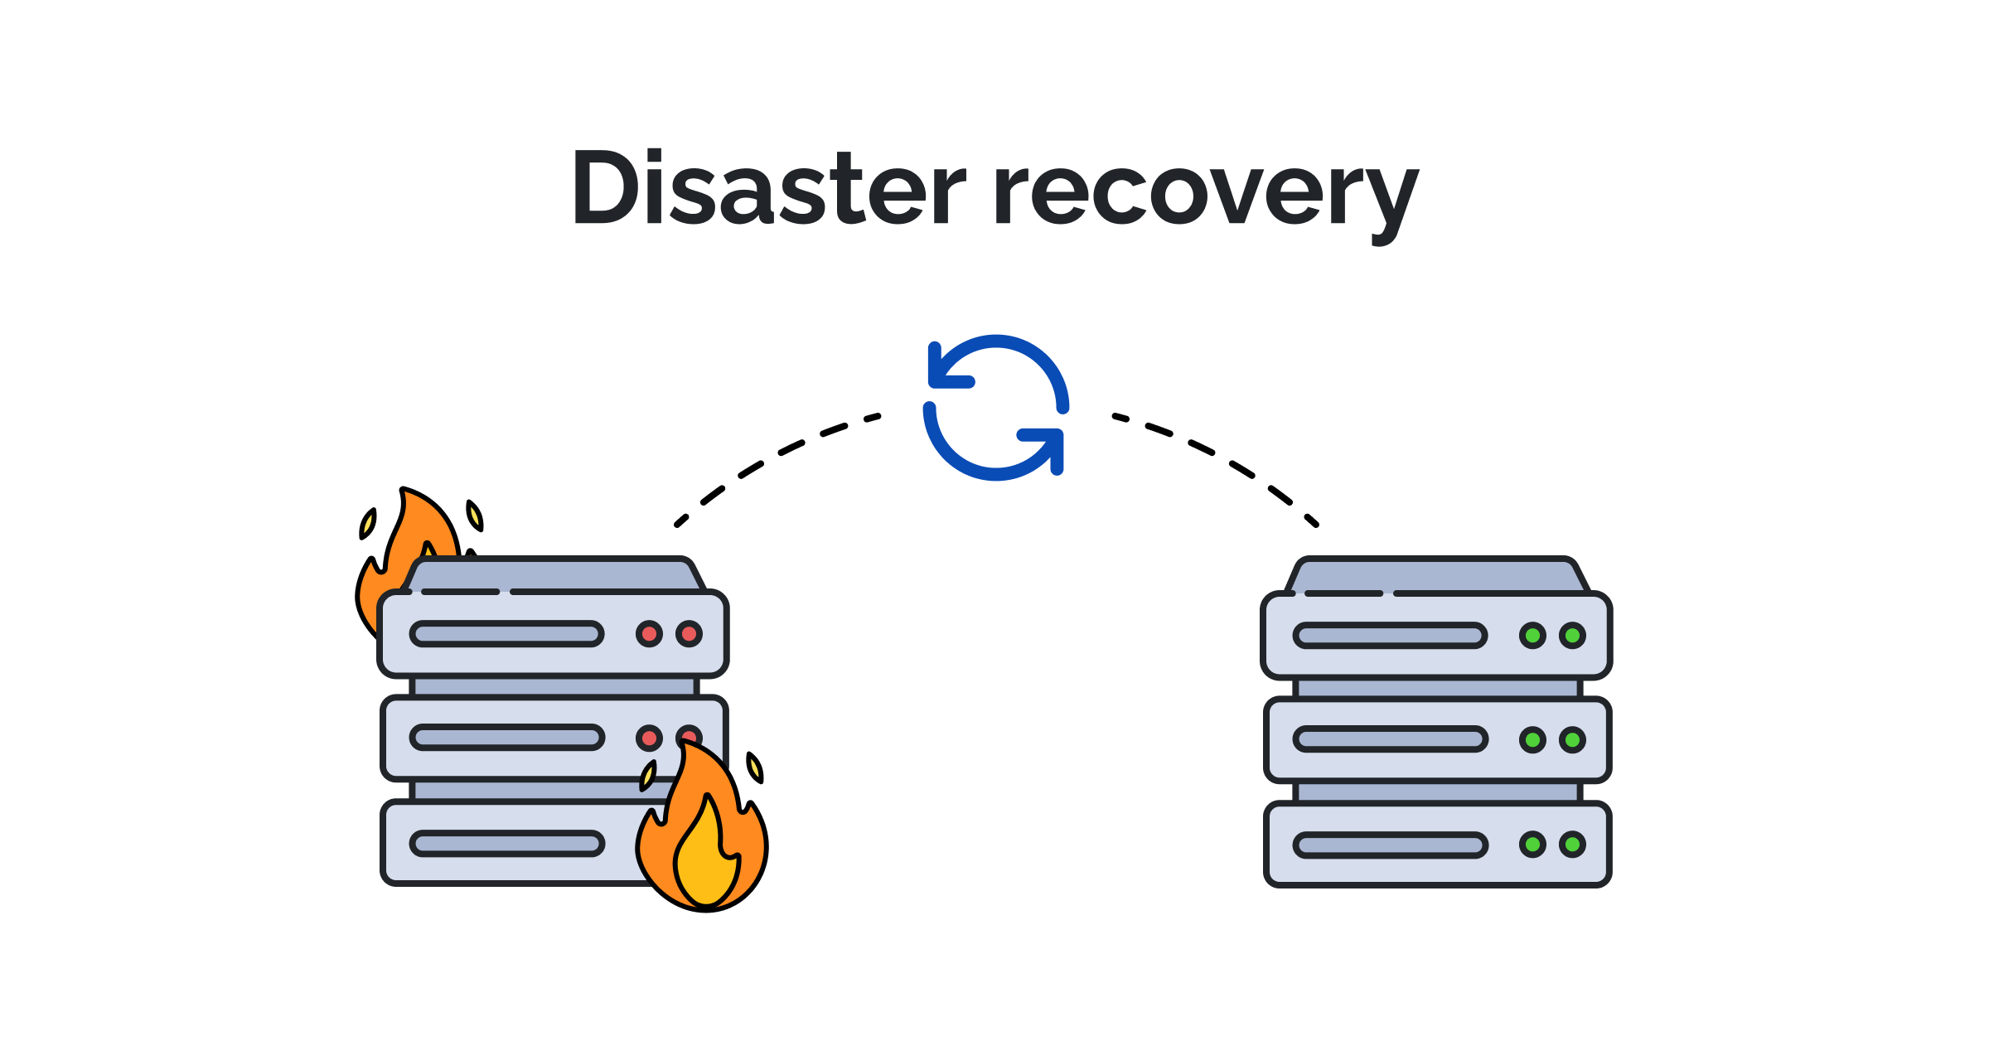

Slide 11
Thank You

